Slide 1
Template to hand out to students in lab
$$α=0$$
$$α=1$$
Sample 1
Sample 2

Slide 2


Students can use one photo to get data on two samples
$$α=0$$
$$α=1$$
Sample 1
Sample 2

Slide 3
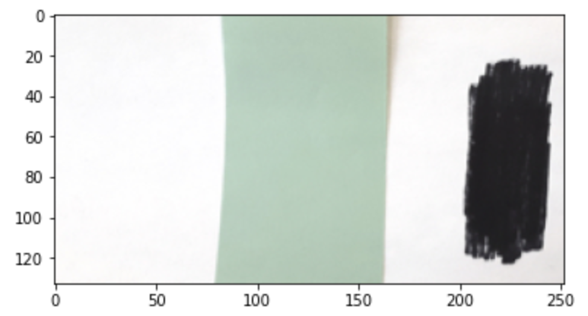
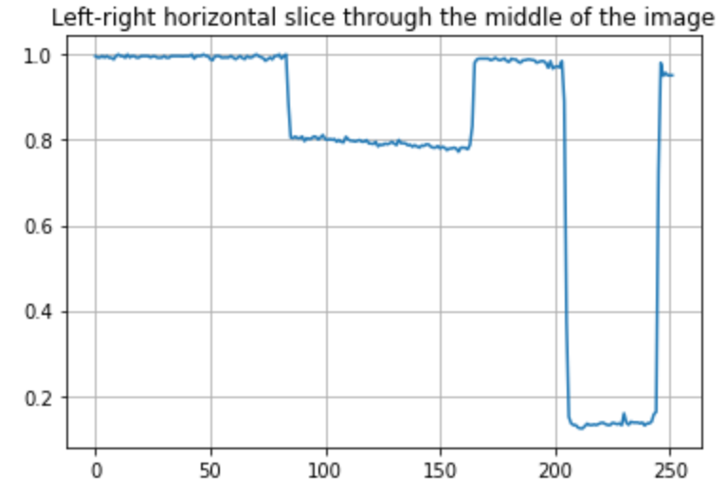
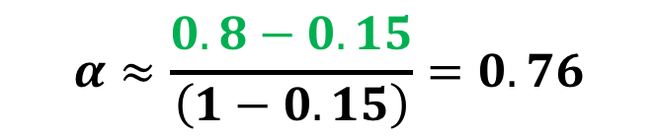
Measuring surface albedo (example)
Image
$$α≈\frac{0.8−0.15}{\left(1−0.15\right)}=0.76$$
=> The albedo of the green surface is 0.76
Intensity of reflected light (arbitrary units)

Slide 4
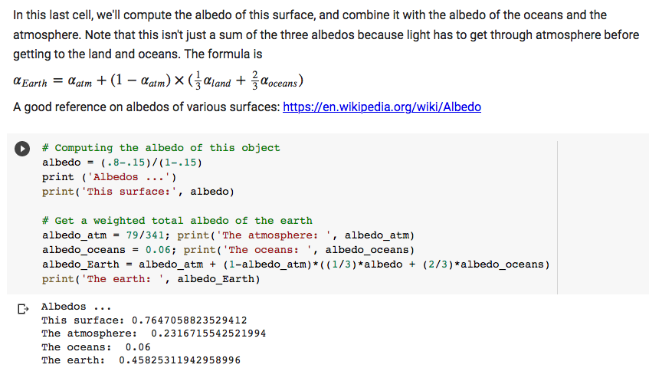
Calculating albedo of this surface and of the Earth as a whole

